Slide 1
VICGOODS LOGISTICS
DEAKIN UNIVERSITY · T1 2026
MIS775 · ASSESSMENT TASK 2
Network Optimisation & Transportation Modelling.
A linear-programming transhipment model minimising weekly freight cost across five plants, two distribution centres and six retail outlets in Victoria.
STUDENT
STUDENT ID
UNIT
TRIMESTER
Nikhil Gupta
225006885
MIS775 · Decision Modelling
T1 · 2026
Notes:
1

Slide 2
SECTION 01 — CONTEXT
INTRODUCTION
Introduction & Business Context
VicGoods Logistics is a fictitious medium-to-large FMCG distribution company operating across Victoria.
Rising fuel costs and tighter service-level expectations have prompted the development of an LP-based decision support model to minimise weekly transportation cost while meeting all retail demand.
5
2
The model is deterministic — supply, demand and unit costs are treated as known constants for the planning horizon.
PRODUCTION PLANTS
DISTRIBUTION CENTRES
Supply 800 pal/wk
Transhipment nodes
PROBLEM
METHOD
Minimise weekly freight cost across a 3-tier network
Linear programming · Simplex transhipment
6
27
OBJECTIVE
TEST
RETAIL OUTLETS
CANDIDATE ROUTES
Meet 550 pal/wk demand at lowest cost
Scenario: two critical routes blocked
Demand 550 pal/wk
Solved with Simplex LP
GEOGRAPHY
Network spans metropolitan Melbourne, Geelong, Ballarat, Bendigo, Shepparton, Warrnambool, Wodonga & Mildura — the full Victorian freight footprint.
MIS775 ASSESSMENT 2 · NIKHIL GUPTA · 225006885
Notes:
2

Slide 3

SECTION 01 — CONTEXT
MODEL ASSUMPTIONS
Network Overview & Assumptions
PARAMETER
VALUE & SOURCE
SUPPLY VS DEMAND
Freight mode
Road freight · B-double trucks (34-pallet)
Supply
Demand
Excess
Unit cost rate
$0.14 per pallet-km · NTC 2023 ($2.80/km ÷ 20 pal)
800
550
250
Distances
Google Maps one-way road distances, April 2026
pallets per week
Supply vs demand
800 supply > 550 demand · unbalanced
Route capacity
Max 170 pal/wk per route (34 × 5 trips)
ROUTE COMPOSITION · 27 TOTAL
10 P→DC
5 direct
12 DC→R
Route count
27 routes · 10 P→DC, 5 direct, 12 DC→R
Planning horizon
Weekly, steady-state; no carry-over
WHY UNBALANCED?
Excess supply lets the LP choose which plants to idle — regional plants may be too costly to activate.
Solver
Simplex LP · Excel Solver add-in
MIS775 ASSESSMENT 2 · NIKHIL GUPTA · 225006885
Notes:
3

Slide 4
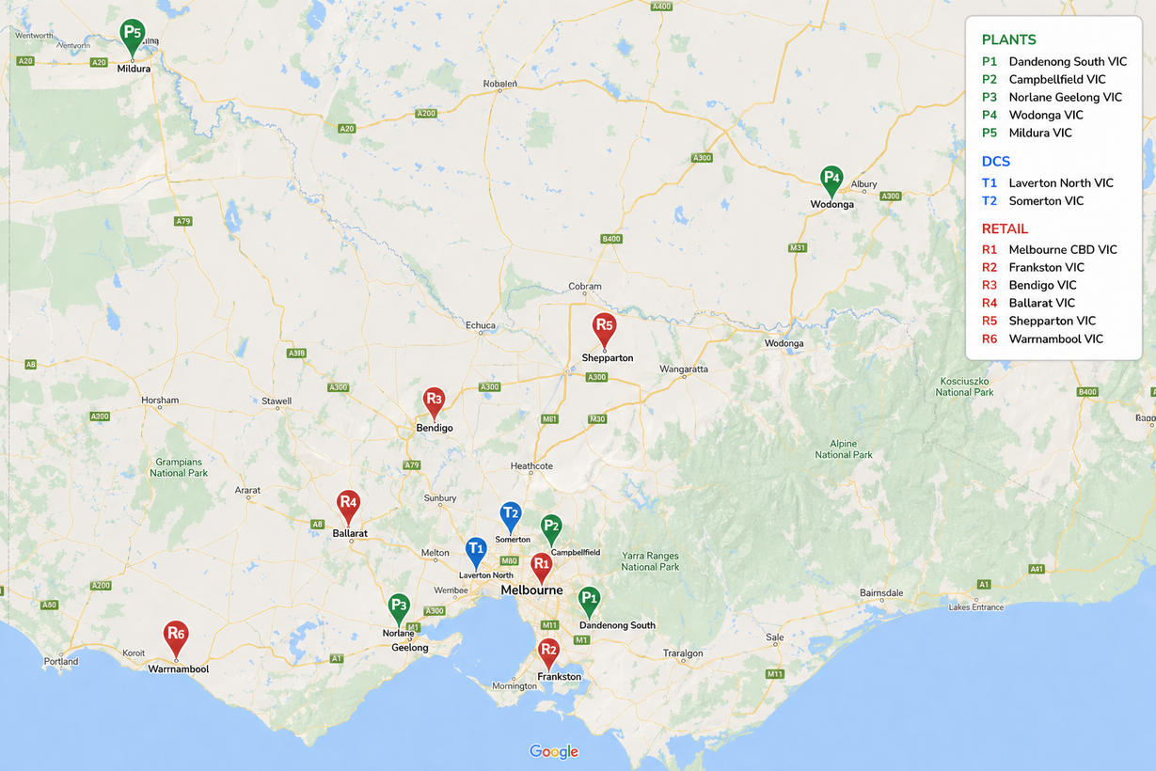
SECTION 02 — NETWORK
NODE LOCATIONS
Node Locations & Rationale
SUPPLY · 5 PLANTS
P1
Dandenong South
200
P2
Campbellfield
180
P3
Geelong (Norlane)
170
P4
Wodonga
130
P5
Mildura
120
Total Supply
800
P1 Victoria's largest industrial precinct · P2 northern Melbourne corridor · P3 port-linked hub · P4 Hume Hwy freight hub · P5 remote NW facility
DEMAND · 6 RETAIL OUTLETS
R1
Melbourne CBD
150
177,396
R2
Frankston
120
142,826
R3
Bendigo
100
121,270
TRANSHIPMENT · 2 DCS
T1
Laverton North
R4
Ballarat
100
118,137
T2
Somerton
R5
Shepparton
55
69,135
T1 — Western Ring Road access, major DC precinct. T2 — northern suburbs, close to Hume Highway.
R6
Warrnambool
25
35,907
Total Demand
550
Populations: ABS 2023 Estimated Resident Population.
Supply 800 − Demand 550 = Excess capacity 250 pallets/week
MIS775 ASSESSMENT 2 · NIKHIL GUPTA · 225006885
Notes:
4

Slide 5
SECTION 02 — NETWORK
COST DERIVATION · 27 ROUTES
Unit Cost Table — All 27 Candidate Routes
Unit cost = distance (km) × $0.14 / pallet-km · ★ indicates direct plant-to-retail route
FROM P1 · DANDENONG STH
FROM P3 · GEELONG
FROM T1 · LAVERTON NTH
FROM T2 · SOMERTON
→ T1 47 km · $6.58
→ T1 62 km · $8.68
→ R1 18 km · $2.52
→ R1 16 km · $2.24
→ T2 41 km · $5.74
→ T2 79 km · $11.06
→ R2 60 km · $8.40
→ R2 57 km · $7.98
→ R1 ★ 35 km · $4.90
→ R4 ★ 75 km · $10.50
→ R3 152 km · $21.28
→ R3 143 km · $20.02
→ R2 ★ 38 km · $5.32
→ R6 ★ 190 km · $26.60
→ R4 111 km · $15.54
→ R4 122 km · $17.08
FROM P2 · CAMPBELLFIELD
FROM P4 · WODONGA
→ R5 198 km · $27.72
→ R5 183 km · $25.62
→ R6 263 km · $36.82
→ R6 281 km · $39.34
→ T1 24 km · $3.36
→ T1 319 km · $44.66
→ T2 9 km · $1.26
→ T2 299 km · $41.86
→ R1 ★ 22 km · $3.08
FROM P5 · MILDURA
→ T1 557 km · $77.98
→ T2 545 km · $76.30
MIS775 ASSESSMENT 2 · NIKHIL GUPTA · 225006885
Notes:
5

Slide 6
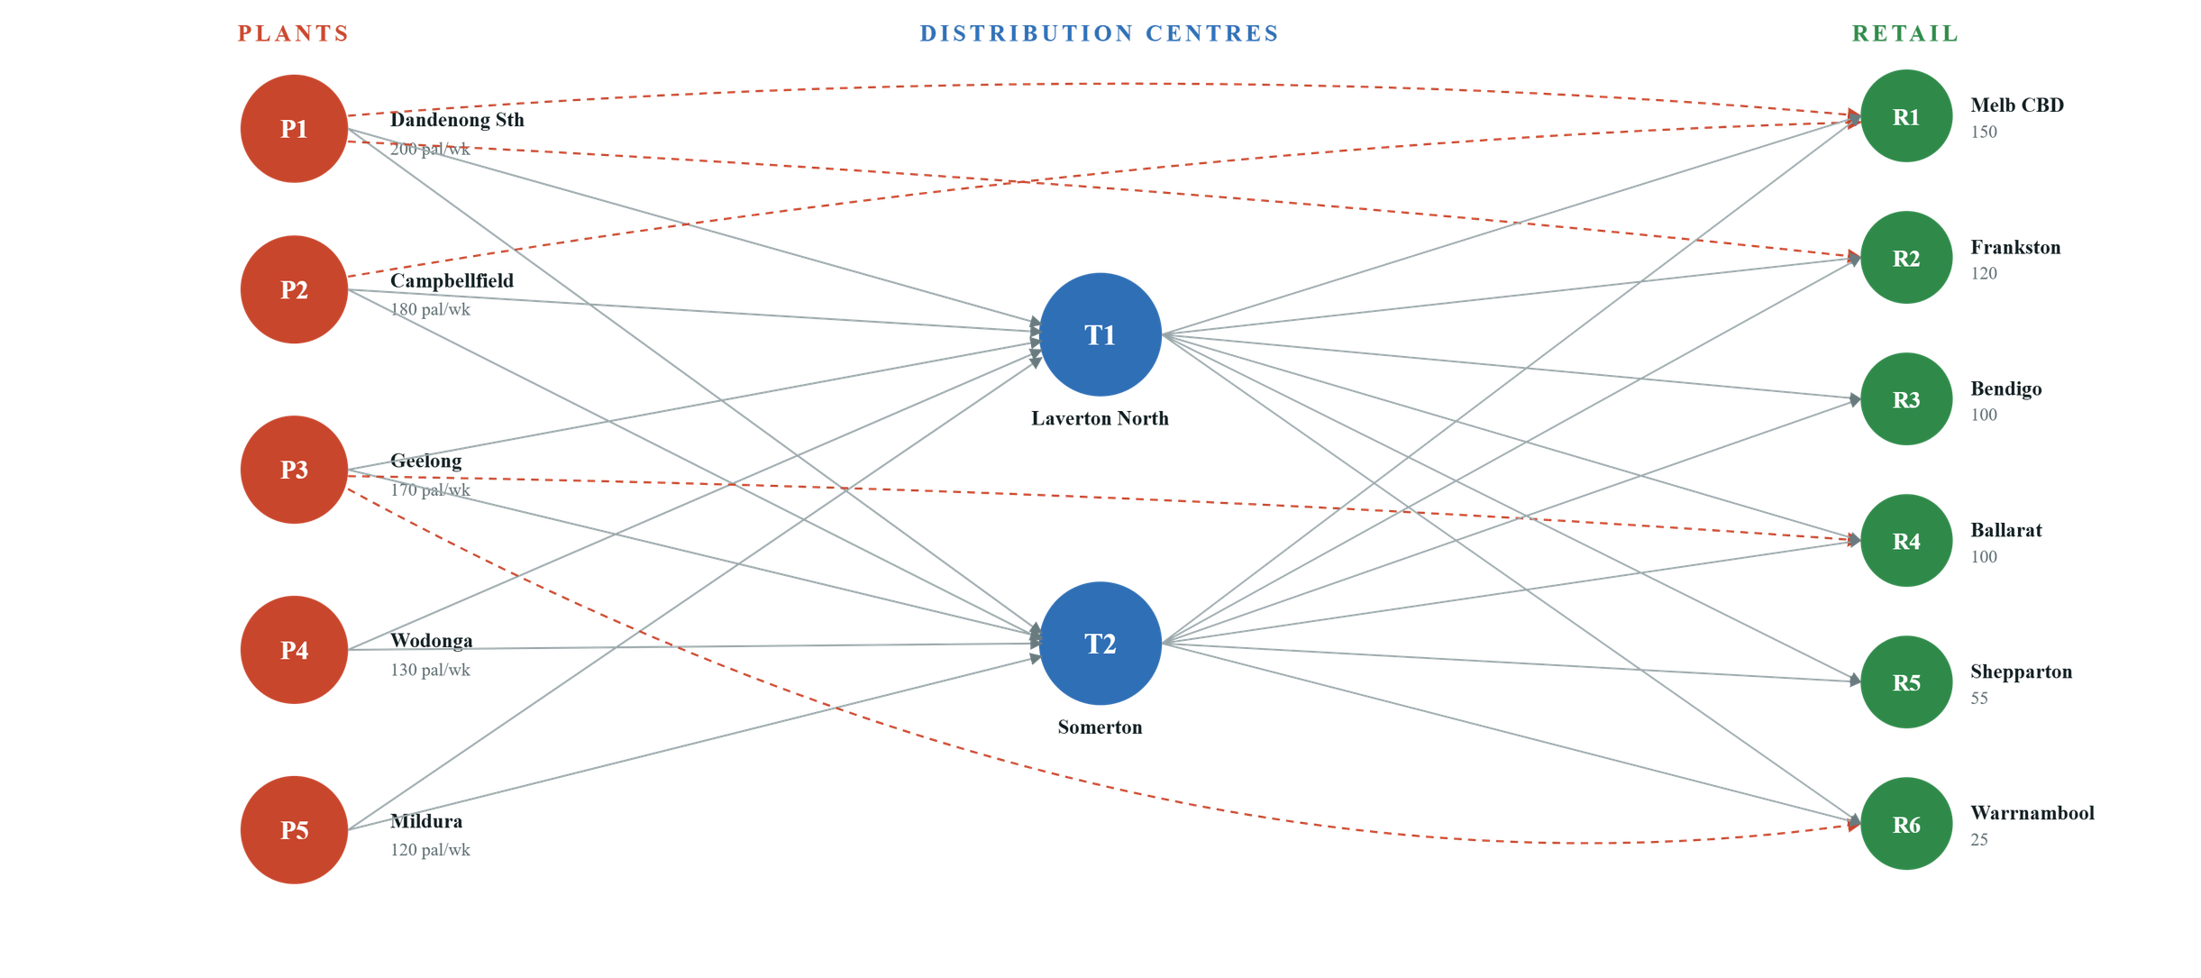
SECTION 02 — NETWORK
CONCEPTUAL DIAGRAM
Conceptual Network Diagram
PLANTS (SUPPLY)
DCS (TRANSHIPMENT)
RETAIL (DEMAND)
SOLID LINE = STANDARD ROUTE · DASHED = DIRECT PLANT → RETAIL
MIS775 ASSESSMENT 2 · NIKHIL GUPTA · 225006885
Notes:
6

Slide 7
SECTION 03 — BASE MODEL
LP FORMULATION
Linear Programming Formulation
DECISION VARIABLES
SUPPLY CONSTRAINTS ( ≤ )
Xij = pallets shipped from node i to node j per week // for each active route (i,j)
XP1,T1 + XP1,T2 + XP1,R1 + XP1,R2 ≤ 200 XP2,T1 + XP2,T2 + XP2,R1 ≤ 180 XP3,T1 + XP3,T2 + XP3,R4 + XP3,R6 ≤ 170 XP4,T1 + XP4,T2 ≤ 130 XP5,T1 + XP5,T2 ≤ 120
OBJECTIVE FUNCTION
Minimise Z = 6.58·XP1,T1 + 5.74·XP1,T2 + 4.90·XP1,R1 + 5.32·XP1,R2 + 3.36·XP2,T1 + 1.26·XP2,T2 + 3.08·XP2,R1 + 8.68·XP3,T1 + 11.06·XP3,T2 + 10.50·XP3,R4 + 26.60·XP3,R6 + 44.66·XP4,T1 + 41.86·XP4,T2 + 77.98·XP5,T1 + 76.30·XP5,T2 + 2.52·XT1,R1 + 8.40·XT1,R2 + 21.28·XT1,R3 + 15.54·XT1,R4 + 27.72·XT1,R5 + 36.82·XT1,R6 + 2.24·XT2,R1 + 7.98·XT2,R2 + 20.02·XT2,R3 + 17.08·XT2,R4 + 25.62·XT2,R5 + 39.34·XT2,R6
TRANSHIPMENT BALANCE ( = 0 )
Σj XT1,j − Σi Xi,T1 = 0 Σj XT2,j − Σi Xi,T2 = 0 // flow in = flow out at each DC
DEMAND CONSTRAINTS ( ≥ )
SOLVER METHOD
XP1,R1 + XP2,R1 + XT1,R1 + XT2,R1 ≥ 150 XP1,R2 + XT1,R2 + XT2,R2 ≥ 120 XT1,R3 + XT2,R3 ≥ 100 XP3,R4 + XT1,R4 + XT2,R4 ≥ 100 XT1,R5 + XT2,R5 ≥ 55 XP3,R6 + XT1,R6 + XT2,R6 ≥ 25
Simplex LP · non-negativity Xij ≥ 0 for all (i,j)
MIS775 ASSESSMENT 2 · NIKHIL GUPTA · 225006885
Notes:
7

Slide 8
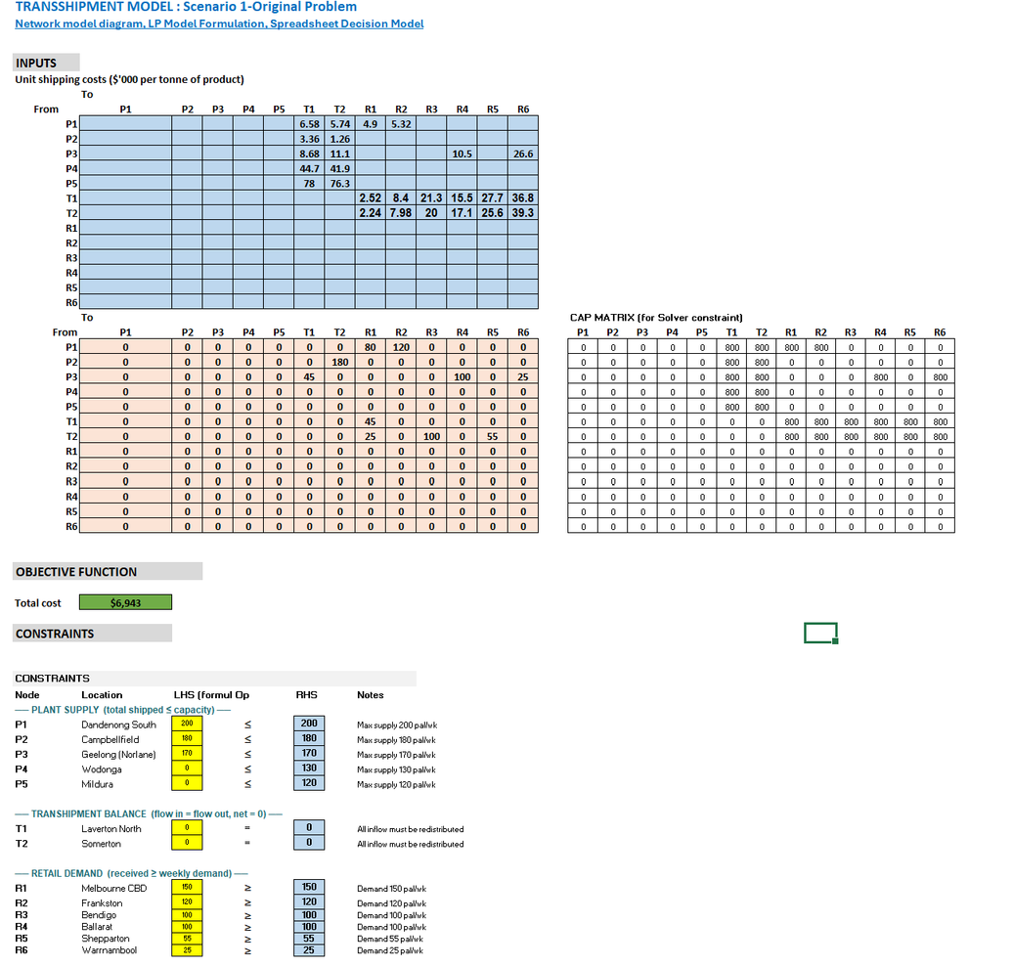
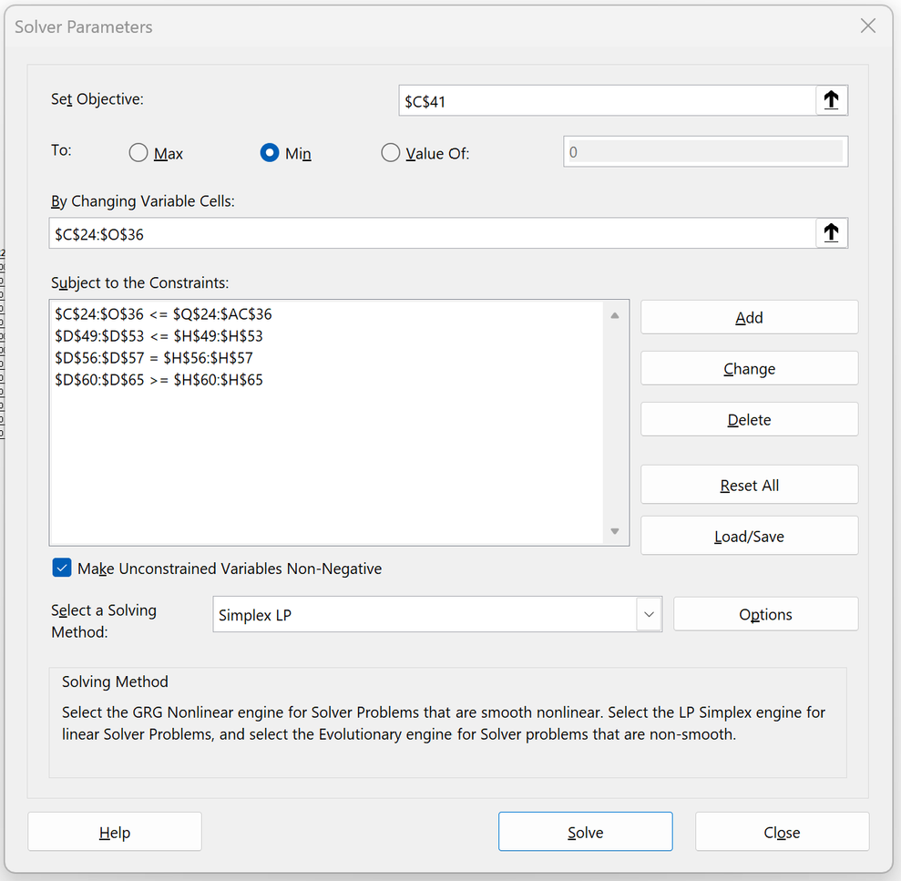
SECTION 03 — BASE MODEL
LP FORMULATION
Linear Programming
Excel Sheet
Solver
MIS775 ASSESSMENT 2 · NIKHIL GUPTA · 225006885

Slide 9
SECTION 03 — BASE MODEL
OPTIMAL SOLUTION
Base Model — Optimal Solution
ROUTE
PALLETS
UNIT $
WEEKLY $
MINIMUM WEEKLY COST
P1 → R1
80
$4.90
$392
$6,943
P1 → R2
120
$5.32
$638
P2 → T2
180
$1.26
$227
550 pallets · 10 active routes
P3 → T1
45
$8.68
$391
P3 → R4
100
$10.50
$1,050
KEY FINDING
P4 (Wodonga) and P5 (Mildura) are completely idle — freight costs of $41–$78/pallet to reach either DC make them uncompetitive. Direct plant to retail routes dominate for metropolitan demand; T2 handles regional distribution.
P3 → R6
25
$26.60
$665
T1 → R1
45
$2.52
$113
T2 → R1
25
$2.24
$56
T2 → R3
100
$20.02
$2,002
IDLE PLANTS
DIRECT ROUTES USED
VIA DCS
T2 → R5
55
$25.62
$1,409
2
4
6
TOTAL — 10 routes
550
$6,943
MIS775 ASSESSMENT 2 · NIKHIL GUPTA · 225006885
Notes:
8

Slide 10
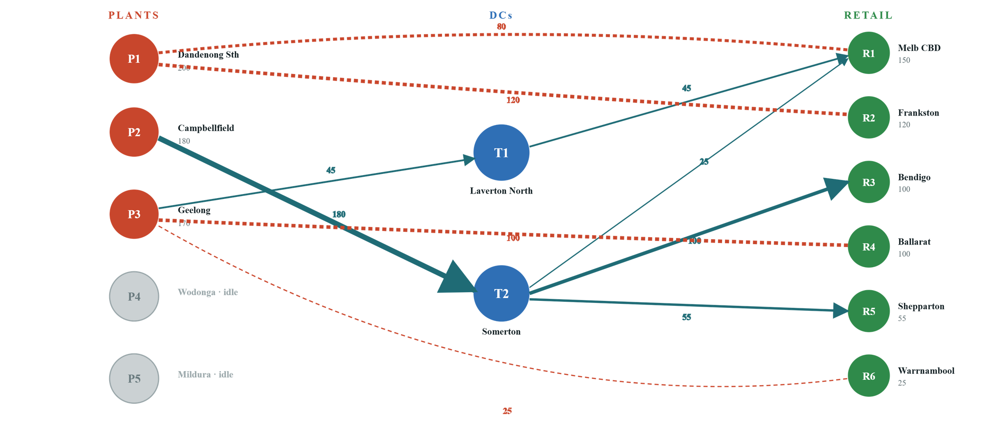
SECTION 03 — BASE MODEL
OPTIMAL FLOW NETWORK
Optimal Flow Network — Base Model
ACTIVE PLANT
IDLE PLANT
DC
RETAIL
ARROW THICKNESS ∝ FLOW VOLUME · LABELS SHOW PALLETS/WEEK
MIS775 ASSESSMENT 2 · NIKHIL GUPTA · 225006885
Notes:
9

Slide 11
SECTION 03 — BASE MODEL
SENSITIVITY ANALYSIS
Sensitivity Analysis — Shadow Prices
NODE
LOCATION
SHADOW PRICE
INTERPRETATION
READ GUIDE
P1
Dandenong South
−$6.30
Each extra pallet of capacity saves $6.30
Negative shadow price = cost saving per extra pallet.
Positive shadow price = cost added per extra pallet demanded.
P2
Campbellfield
−$7.70
Most valuable plant — extra capacity saves $7.70
P3
Geelong
$0
Not fully utilised; extra capacity adds no value
P4
Wodonga
$0
Idle — prohibitive freight costs
HEADLINE INSIGHT
P5
Mildura
$0
Idle — prohibitive freight costs
Increasing P2 (Campbellfield) capacity yields the greatest cost reduction at $7.70/pallet — it sits on the binding supply constraint and feeds the cheapest plant-to-DC link in the network ($1.26).
T1
Laverton North
−$8.68
Extra throughput saves $8.68/pallet
T2
Somerton
−$8.96
Extra throughput saves $8.96/pallet
R1
Melbourne CBD
+$11.20
Each extra pallet demanded adds $11.20
R3
Bendigo
+$28.98
Second most expensive to serve
R5
Shepparton
+$34.58
Most expensive demand node
MIS775 ASSESSMENT 2 · NIKHIL GUPTA · 225006885
Notes:
10

Slide 12
SECTION 04 — SCENARIO
DISRUPTION ANALYSIS
Scenario — Two Critical Routes Blocked
We simulate a plausible infrastructure disruption affecting Victoria's two busiest freight corridors to test the network's resilience.
ROUTE 1 · BLOCKED
ROUTE 2 · BLOCKED
P2 → T2
T2 → R3
Campbellfield → Somerton · 9 km · $1.26/pallet
Somerton → Bendigo · 143 km · $20.02/pallet
Base flow
180 pal/wk
Base flow
100 pal/wk
Share of total demand
32.7%
Criticality
Sole supply to Bendigo
Cause
Road construction — Western Ring Road / Hume Hwy interchange
Cause
Flooding on Calder Freeway
COMBINED BASE FLOW
COST @ BASE
AFFECTED DEMAND NODE
RESEARCH QUESTION
280 pal/wk
$2,229
R3 Bendigo
Can the network still meet all demand — and at what cost?
50.9% of weekly demand
32.1% of base OF value
100 pal · no fallback lane
MIS775 ASSESSMENT 2 · NIKHIL GUPTA · 225006885
Notes:
11

Slide 13
SECTION 04 — SCENARIO
DISRUPTED LP FORMULATION
Disrupted Model — LP Changes
Structure is unchanged. Two equality constraints force the blocked routes to zero — all other supply, transhipment and demand constraints are identical.
UNCHANGED COMPONENTS
5 CONSTRAINTS
2 CONSTRAINTS
Supply ( ≤ )
Transhipment ( = 0 )
ADDED CONSTRAINTS
6 CONSTRAINTS
ALL Xᵢⱼ
XP2,T2 = 0 ✕ XT2,R3 = 0 ✕
Demand ( ≥ )
Non-negativity
REMOVED FROM OBJECTIVE
+ 1.26·XP2,T2
// $227 base contribution
+ 20.02·XT2,R3
// $2,002 base contribution
VARIABLE COUNT DELTA
27
→
25
active variables
SOLUTION PIPELINE
Reduce Model
→
Simplex LP
→
New Optimum
Blocked routes are effectively removed from the objective function and from every constraint in which they appeared — no new routes are introduced.
MIS775 ASSESSMENT 2 · NIKHIL GUPTA · 225006885
Notes:
12

Slide 14
SECTION 04 — SCENARIO
DISRUPTED SOLUTION
Disrupted Model — Optimal Rerouting
ROUTE
BASE
DISRUPTED
STATUS
P2 → T2
180
→
0
BLOCKED
NEW MINIMUM WEEKLY COST
P2 → T1
0
→
180
REROUTED
$7,570
T2 → R3
100
→
0
BLOCKED
T1 → R3
0
→
100
+$627 vs base · +9.03%
REROUTED
T1 → R5
0
→
55
SHIFTED TO T1
FEASIBILITY
T2 → R5
55
→
0
SHIFTED
All 550 pallets of weekly demand are still met — the network remains feasible. Every impacted flow is absorbed by the Laverton North DC (T1).
T1 → R1
45
→
70
INCREASED
T2 → R1
25
→
0
ABSORBED
Routes not listed are unchanged from the base model.
MIS775 ASSESSMENT 2 · NIKHIL GUPTA · 225006885
Notes:
13

Slide 15
SECTION 04 — SCENARIO
COST COMPARISON
Cost Impact — Base vs Disrupted
$6,943
BREAKDOWN OF $627 INCREASE
Base Model
P2 rerouting · P2→T2 to P2→T1
+$378
60.3% of total increase
Disrupted
$7,570
Bendigo rerouting · T2→R3 to T1→R3
+$126
20.1% of total increase
Cascade adjustments
+$123
WEEKLY DELTA
% INCREASE
ANNUAL IMPACT
+$627
+9.03%
+$32,604
19.6% of total increase
MIS775 ASSESSMENT 2 · NIKHIL GUPTA · 225006885
Notes:
14

Slide 16
SECTION 04 — SCENARIO
SENSITIVITY COMPARISON
Shadow Prices — Base vs Disrupted
NODE
BASE
DISRUPTED
CHANGE
INTERPRETATION
P1
−$6.30
−$6.30
—
Unchanged role
KEY INSIGHT
P2
−$7.70
−$5.32
−$2.38
Less valuable after forced reroute
T2's shadow price rose to −$10.78 — Somerton DC is under greater stress when T2→R3 is blocked, because it still handles R1, R2, and R4 traffic with tighter slack.
T1
−$8.68
−$8.68
—
Same throughput value
T2
−$8.96
−$10.78
+$1.82
More constrained under disruption
R3
+$28.98
+$29.96
+$0.98
Bendigo more expensive to serve
R5
+$34.58
+$36.40
+$1.82
Shepparton more expensive
MIS775 ASSESSMENT 2 · NIKHIL GUPTA · 225006885
Notes:
15

Slide 17
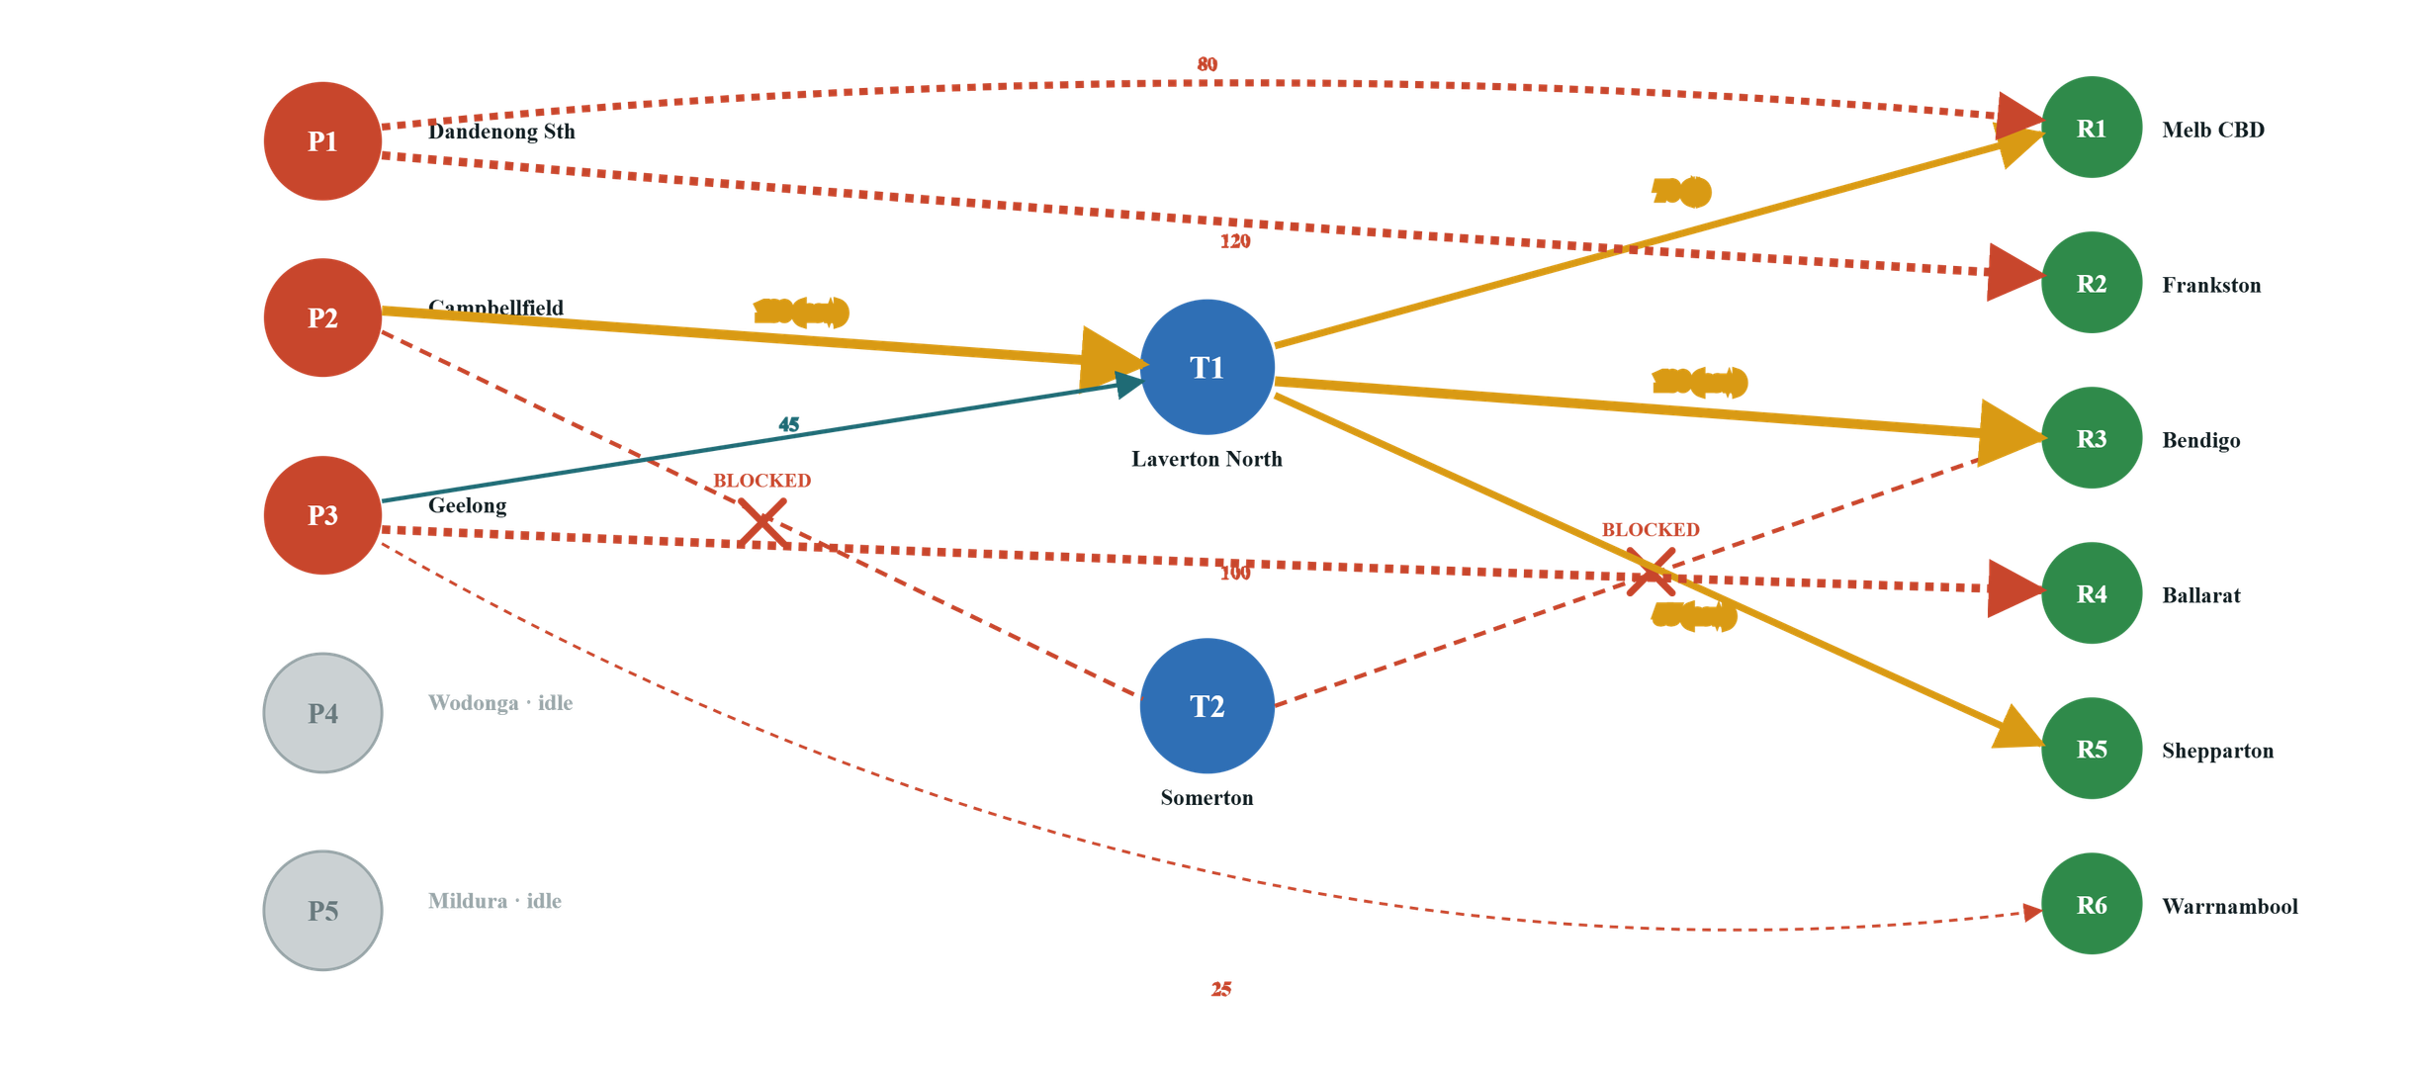
SECTION 04 — SCENARIO
DISRUPTED FLOW NETWORK
Disrupted Flow Network
BLOCKED ROUTE
NEW / INCREASED ROUTE
UNCHANGED FLOW
MIS775 ASSESSMENT 2 · NIKHIL GUPTA · 225006885
Notes:
16

Slide 18
SECTION 05 — FINDINGS
CONCLUSIONS
Conclusions
01
Optimal Solution
HEADLINE KPIS
VicGoods achieves a minimum weekly cost of $6,943 using 10 active routes, favouring direct plant-to-metro routes and the Somerton DC for regional distribution.
$6,943
$7,570
Base weekly cost
Disrupted cost
10
+9.0%
02
Network Efficiency
Active routes
Cost premium
250 pallets/week of excess supply remain unused, concentrated at Wodonga (P4) and Mildura (P5) — too costly to activate at current demand.
FLOW SHARE BY DC · BASE
T1 · 180
T2 · 180
Direct · 190
03
Resilience
32.7%
32.7%
34.5%
A 9.03% cost increase under disruption confirms moderate network resilience — all demand is still met, but at higher cost.
BOTTOM LINE
Model is cost-efficient but structurally fragile — resilience requires pre-planned rerouting, not reactive response.
04
Strategic Vulnerability
P2's sole reliance on T2 in the base model represents a single point of failure the scenario analysis exposed.
05
T2 Dependency
The Somerton DC handles 32.7% of total weekly flow in the base model — the most critical node in the network.
MIS775 ASSESSMENT 2 · NIKHIL GUPTA · 225006885
Notes:
17

Slide 19
SECTION 05 — FINDINGS
RECOMMENDATIONS
Recommendations
01 · CONTINGENCY ROUTING
02 · EMERGENCY PLANT ACTIVATION
Pre-negotiated P2 → T1 freight contracts
Formal protocol for Wodonga & Mildura
Activatable during Somerton DC disruptions. A $2.10/pallet premium is justified as operational insurance.
Activate P4 & P5 during supply-side disruptions, accepting higher freight cost as contingency spend.
03 · DIRECT ROUTE DEVELOPMENT
04 · INFRASTRUCTURE ADVOCACY
Open a direct P3 → R3 lane
Flag critical freight corridors
Geelong → Bendigo (152 km, $21.28/pallet) as alternative supply, bypassing both DCs.
Raise Western Ring Road & Calder Freeway with Victorian transport authorities — they carry 32.7% of weekly distribution.
05 · DC REDUNDANCY
Shared DC agreements at Laverton North (T1)
Investigate co-use arrangements with other FMCG operators to increase T1 throughput — its −$8.68 shadow price signals high marginal value.
MIS775 ASSESSMENT 2 · NIKHIL GUPTA · 225006885
Notes:
18

Slide 20
SECTION 06 — BACK MATTER
REFERENCES
References
Australian Bureau of Statistics (2023).
Regional Population 2022–23. ABS.
https://www.abs.gov.au/statistics/people/population/regional-population
National Transport Commission (2023).
Heavy Vehicle Charges Determination. NTC.
https://www.ntc.gov.au
Victoria in Future (2023).
Population and household projections to 2051. Department of Transport and Planning, Victoria.
https://www.planning.vic.gov.au
Google Maps (2026).
Road distance measurements between Victorian locations. Accessed April 2026.
https://maps.google.com
Born Again Pallets (2024).
Freight Capacity: Pallet Configuration for Semi Trailers and B Doubles.
https://www.bornagainpallets.com
MIS775 ASSESSMENT 2 · NIKHIL GUPTA · 225006885
Notes:
19

